Slide 1

Kinetic Energy

Slide 2
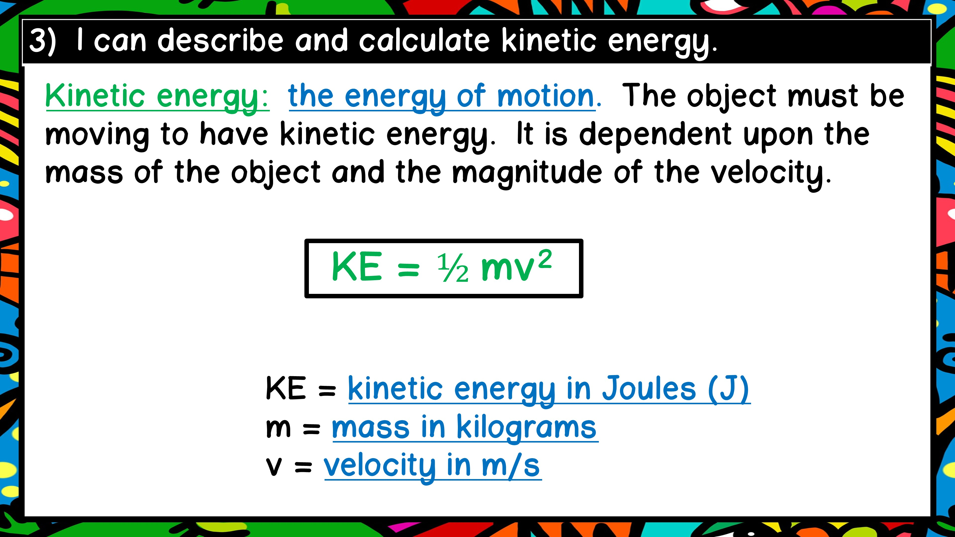

Slide 3
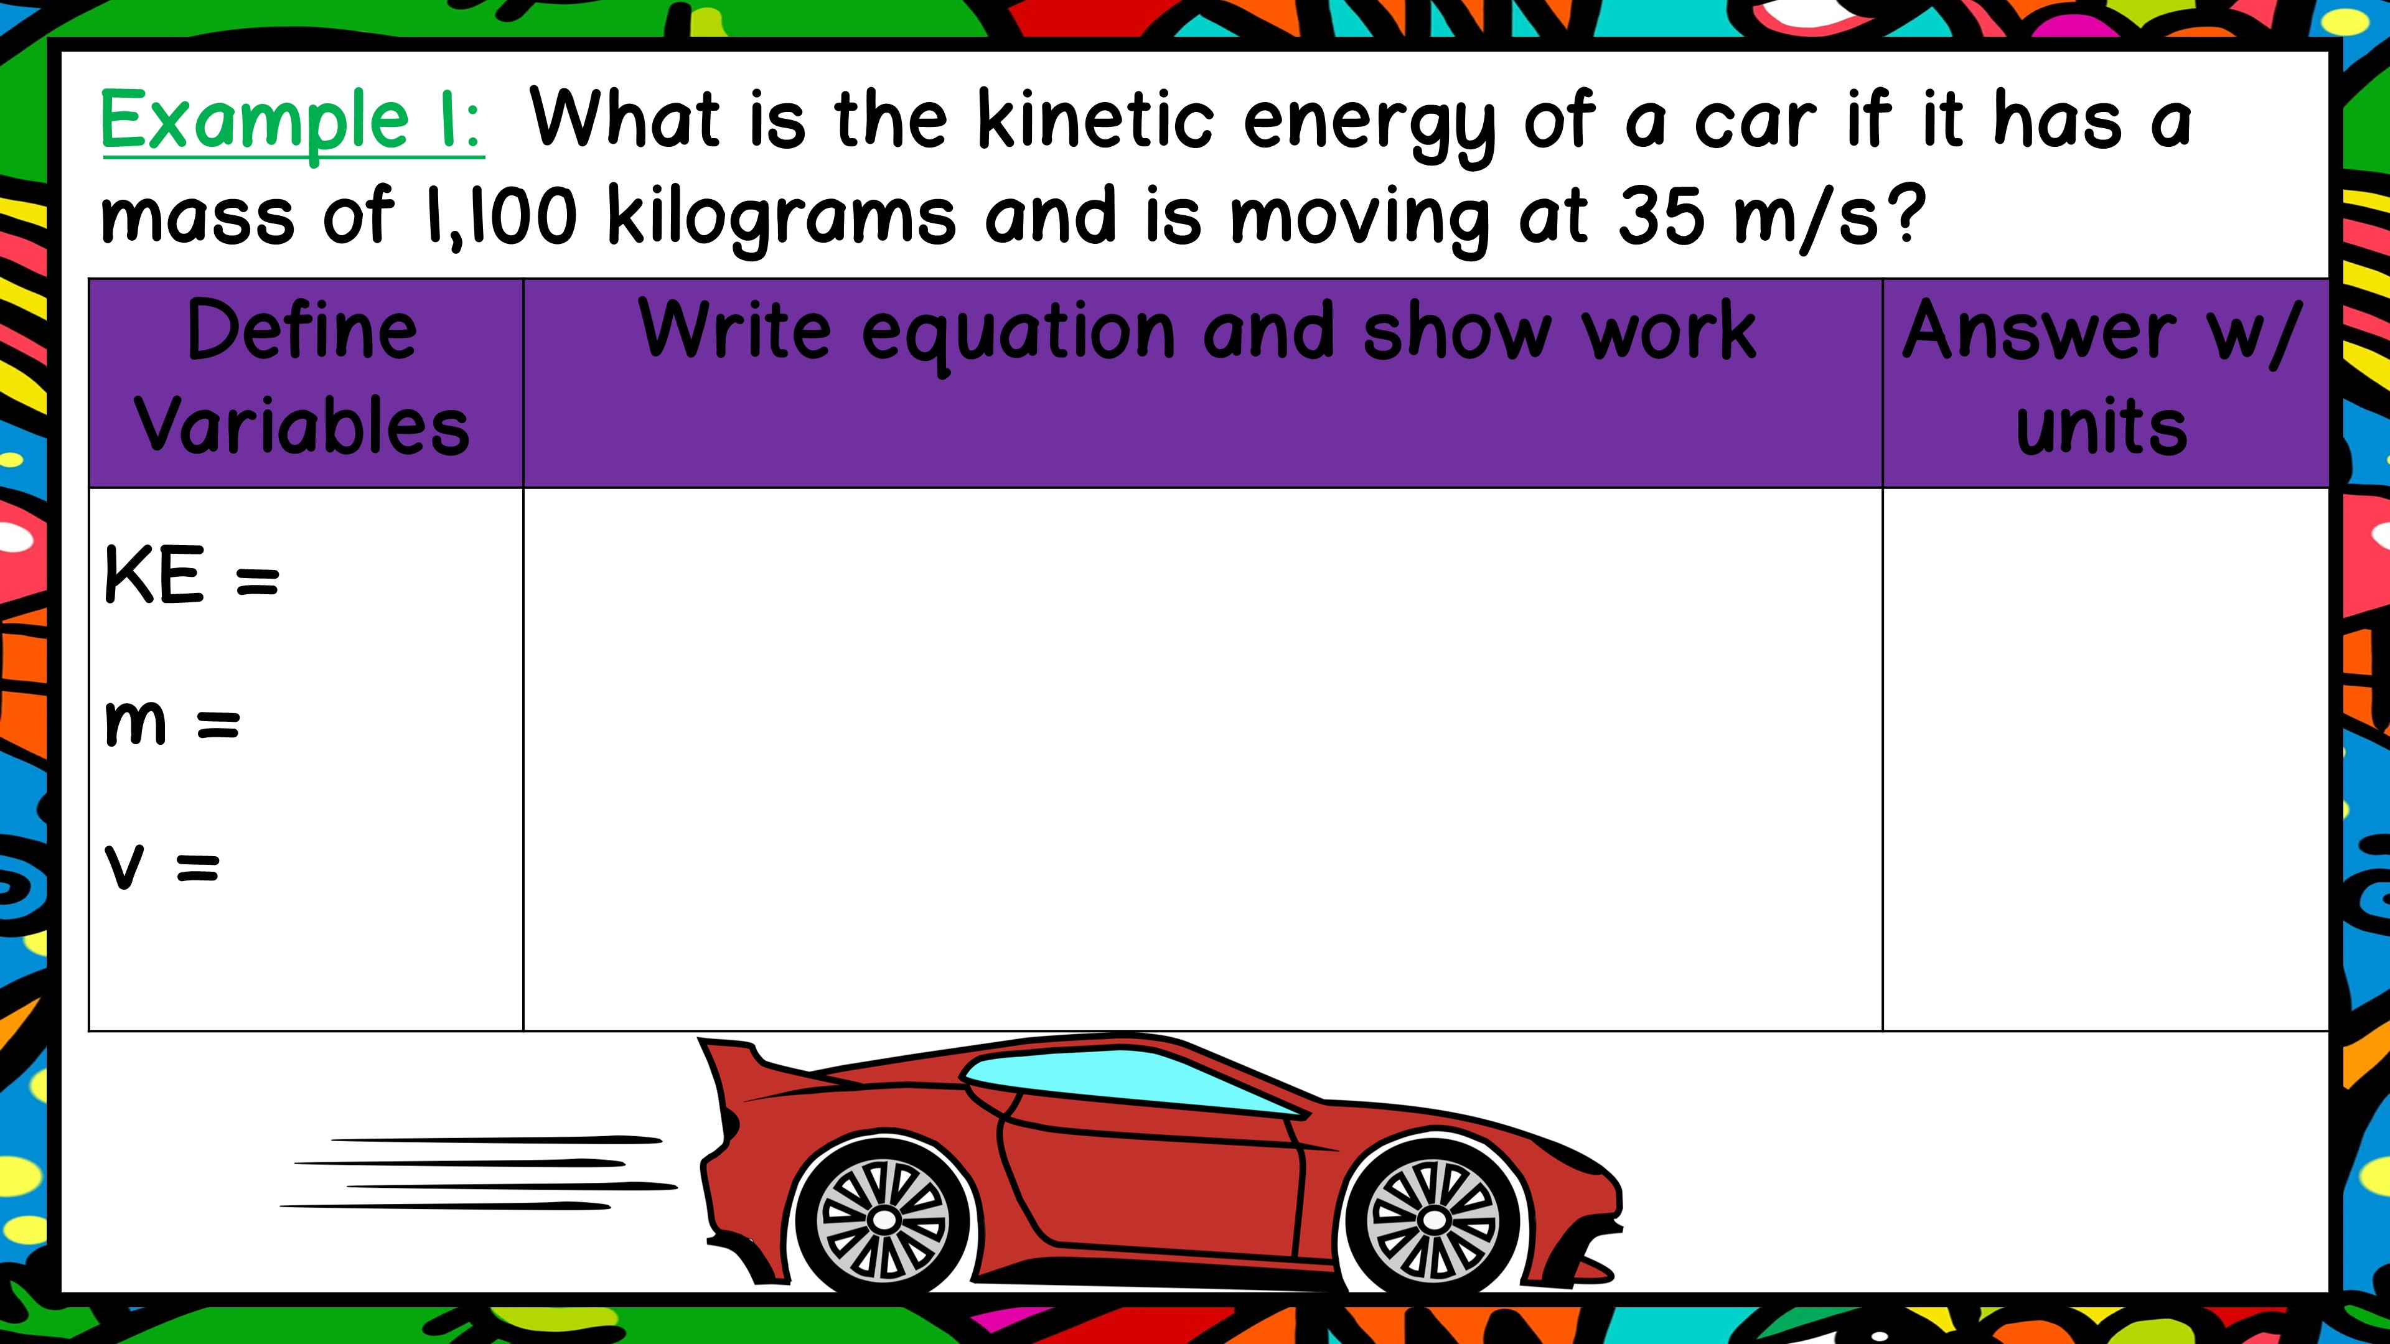

Slide 4
?
1100 kg
35 m/s

Slide 5
?
1100 kg
35 m/s
KE = ½ m v²
KE = 0.5 x 35 x (1100)²
KE = 21175000 J
KE =
2.12 x 10⁷ J

Slide 6
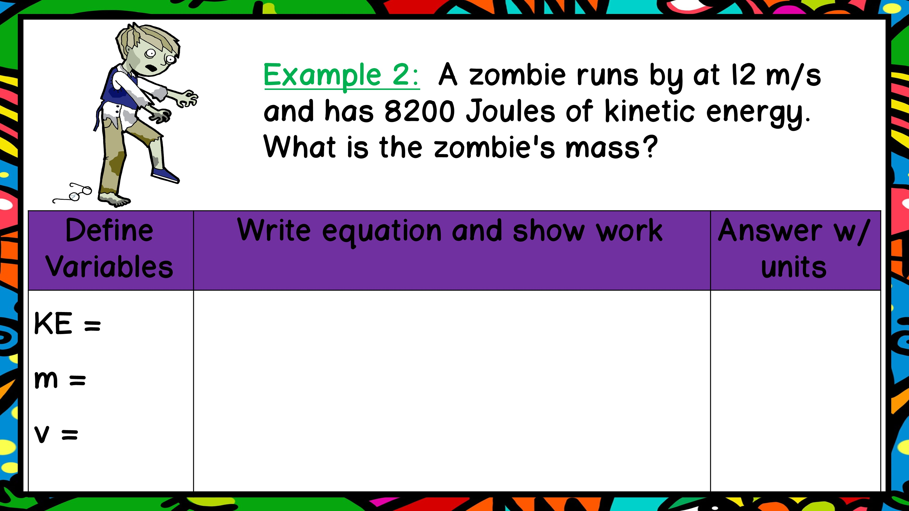

Slide 7
8200 J
?
12 m/s

Slide 8
8200 J
?
12 m/s
KE = ½ m v²
8200 = 0.5 x m x (12)²
8200 = 72m
m = 8200/72 = 114 kg
m = 114 kg

Slide 9
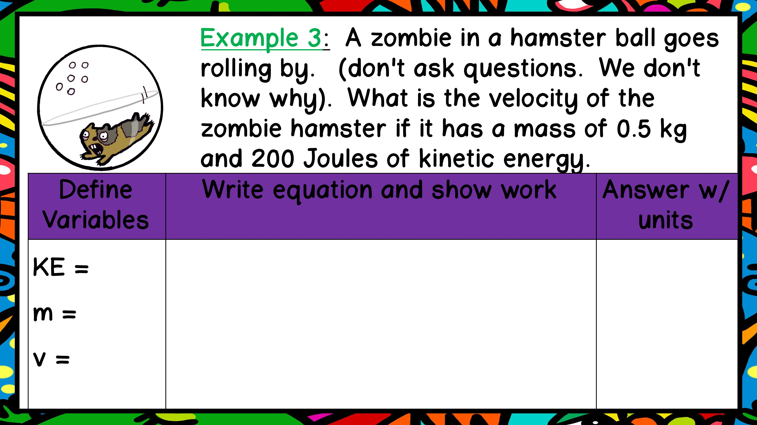

Slide 10
200 J
0.5 kg
?

Slide 11
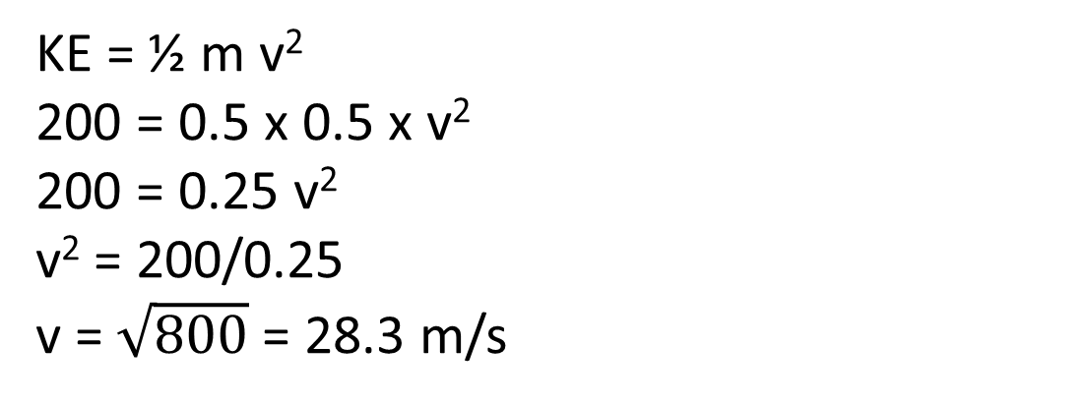
200 J
0.5 kg
?
KE = ½ m v²
200 = 0.5 x 0.5 x v²
200 = 0.25 v²
v² = 200/0.25
v = $\sqrt{800}$ = 28.3 m/s
v = 28.3 m/s

